Slide 1
Moment of a Force About a Point (scalar calculation)
Dr. Jacob Moore
Associate Professor of Engineering
Penn State Mont Alto

Slide 2
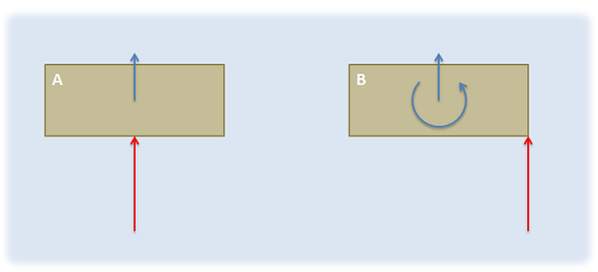
Moments
A moment of a force is the tendency of that force to cause a rotation of a body in the form of an angular acceleration.
M

Slide 3

Moment of a Force About a Point (2D Scalar Calculations)
To calculate the moment, we must first choose the point we are taking the moment about.
You can take the moment about any point, but the moment you calculate will only be valid about the point you choose.
We will often use a subscript to indicate the point we are taking the moment about
M_{A}
A
B
$$F$$

Slide 4


Moment of a Force About a Point (2D Scalar Calculations)
The moment of a force about a point will have a magnitude and direction.
The magnitude of the moment will be the magnitude of the force times the perpendicular distance between the force and the point.
M_{A}
d
B
A
$$M=F∗d$$
$$F$$

Slide 5
Moment of a Force About a Point (2D Scalar Calculations)
The direction of the moment will be determined by the direction of rotation the force would cause.
Counter-clockwise is Positive
Clockwise is Negative
M_{A}
d
B
A
$$M=F∗d$$
$$F$$

Slide 6
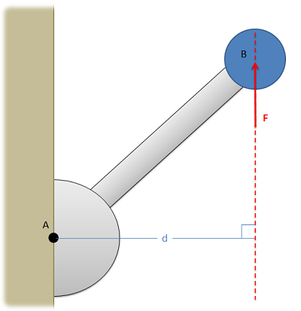
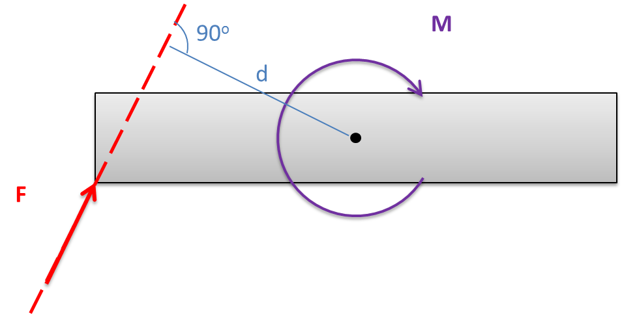

Perpendicular Distances
The distance in the moment calculations will always be the shortest distance between the line of action of the force and the point we are taking the moment about.
This will always be a line that is perpendicular to the line of action of the force.
$$M=F∗d$$
M

Slide 7
Moment of a Force About a Point (3D Scalar Calculations)
In three dimensions, we will need to modify our calculations slightly to make them work.
The magnitude of the moment will still be the magnitude of the force times the perpendicular distance.
Finding this distance can be quite difficult
The direction of the moment will now be represented through the moment vector. The moment vector lies along the axis the body would rotate about.

Slide 8
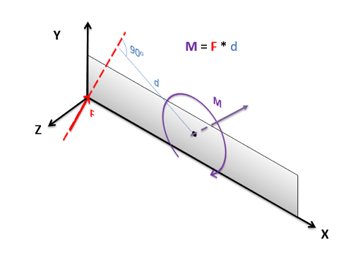
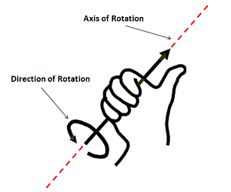
Moment of a Force About a Point (3D Scalar Calculations)
To visualize the direction of a moment vector, we will use the right-hand rule.
Take your right hand and curl your fingers in the direction of rotation the force would cause.
Stick your thumb strait out. Your thumb should line up with the axis of rotation and indicates the direction of the moment vector.

Slide 9
Complex 3D Moment Calculations
While it is theoretically possible to calculate any moment using this method, the geometry of the perpendicular distances and finding the direction of the moment vector can become very difficult.
For this reason, we usually resort to the vector methods of calculation when the problems become too complex.

Slide 10
Thanks for Watching
See other engineering mechanics videos and access the full tool at…

Slide 11
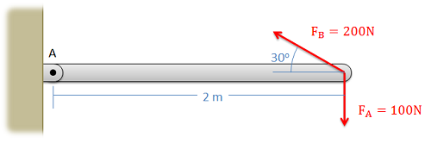
Moments Worked Example
Determine the moment that…
Force A exerts about point A
Force B exerts about point B

Slide 12
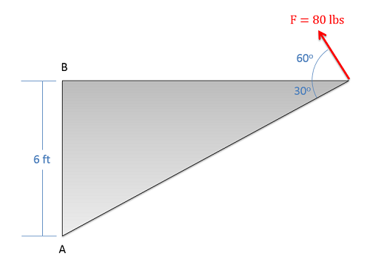
Moments Worked Example
Determine the moment that the force exerts about…
Point A
Point B

Slide 13
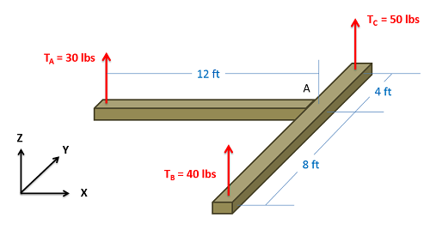
Moments Worked Example
What are the moments that each of the three tension forces exert about point A? Provide the answer as a vector.

